Slide 1
When it comes to car crashes, when do injuries occur? What about fatalities?
An Investigation by Nabil Darwich and Hamza Mughal
Using real crash data from the City of Chicago from the summer of 2018

Slide 2
Finding a Good Dataset
Original Data: Montgomery County’s Traffic Violations https://data.montgomerycountymd.gov/Public-Safety/Traffic-Violations/4mse-ku6q
Violation info from all electronic traffic violations in Montgomery County
1m+ records
Significant Columns:
Geolocation
Time of stop
Accident (Y/N)
Belts (Y/N)
Personal Injury (Y/N)
Fatal (Y/N)
Alcohol (Y/N)
Driver race/gender/city/state
Vehicle make/model/year/type

Slide 3
Why We Switched
Many Inconsistencies, lack of good management/verification
The Accident Column never had a YES, even when fatalities occurred
Drivers were charged with DUI/DWI, but the Alcohol column indicated NO
Seatbelt violations when Seatbelt column indicated a seatbelt was worn
Overall improperly recorded data
No data on vehicle passengers/pedestrians involved
Lack of a standardized format
Descriptions sometimes included spelling errors
Info was sometimes entered by a human, causing subjectivity
Too many non-accidents, useless for our problem statement
Not enough relevant columns to build a good model

Slide 4
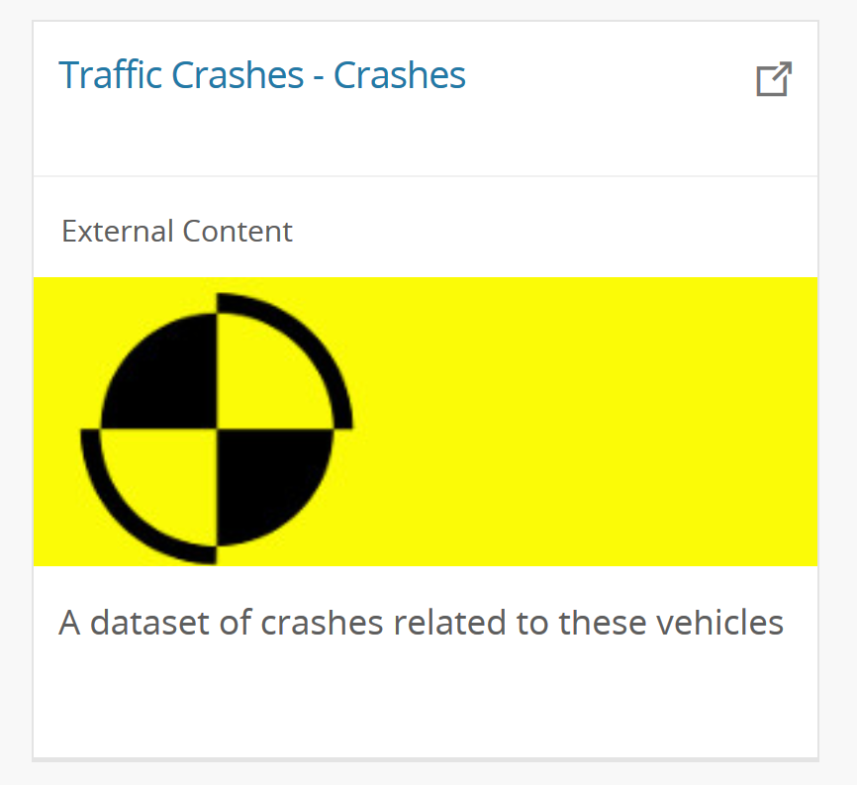
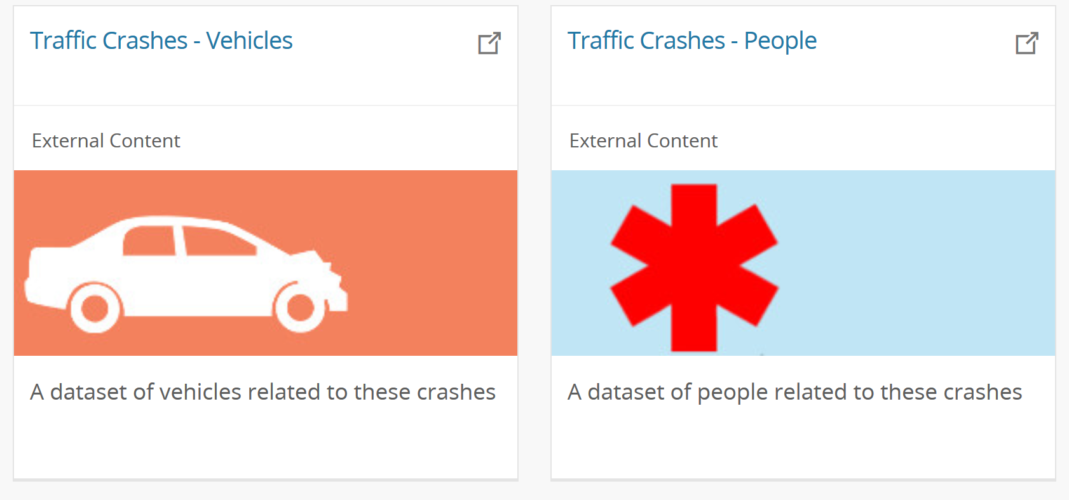
New Data: Traffic Crashes from the City of Chicago
Not only one dataset, but 3
Dataset about the crash
RD_NO, DATE, ROAD_DEFECT, TYPE, WEATHER. LIGHTING, PRIM_CAUSE, …

Slide 5
New Data: Traffic Crashes from the City of Chicago
Not only one dataset, but 3
Dataset about the crash
RD_NO, DATE, ROAD_DEFECT, TYPE, WEATHER. LIGHTING, PRIM_CAUSE, …
Dataset about the vehicles involved
RD_NO, NUM_PASSENGERS, MAKE, MODEL, EXCEED_SPEED_LIMIT, …

Slide 6
New Data: Traffic Crashes from the City of Chicago
Not only one dataset, but 3
Dataset about the crash
RD_NO, DATE, ROAD_DEFECT, TYPE, WEATHER. LIGHTING, PRIM_CAUSE, …
Dataset about the vehicles involved
RD_NO, NUM_PASSENGERS, MAKE, MODEL, EXCEED_SPEED_LIMIT, …
Dataset about the individuals involved
RD_NO, SEX, AGE, PERSON_TYPE (DRIVER/PASSENGER/PED), BAC_RESULT, …

Slide 7
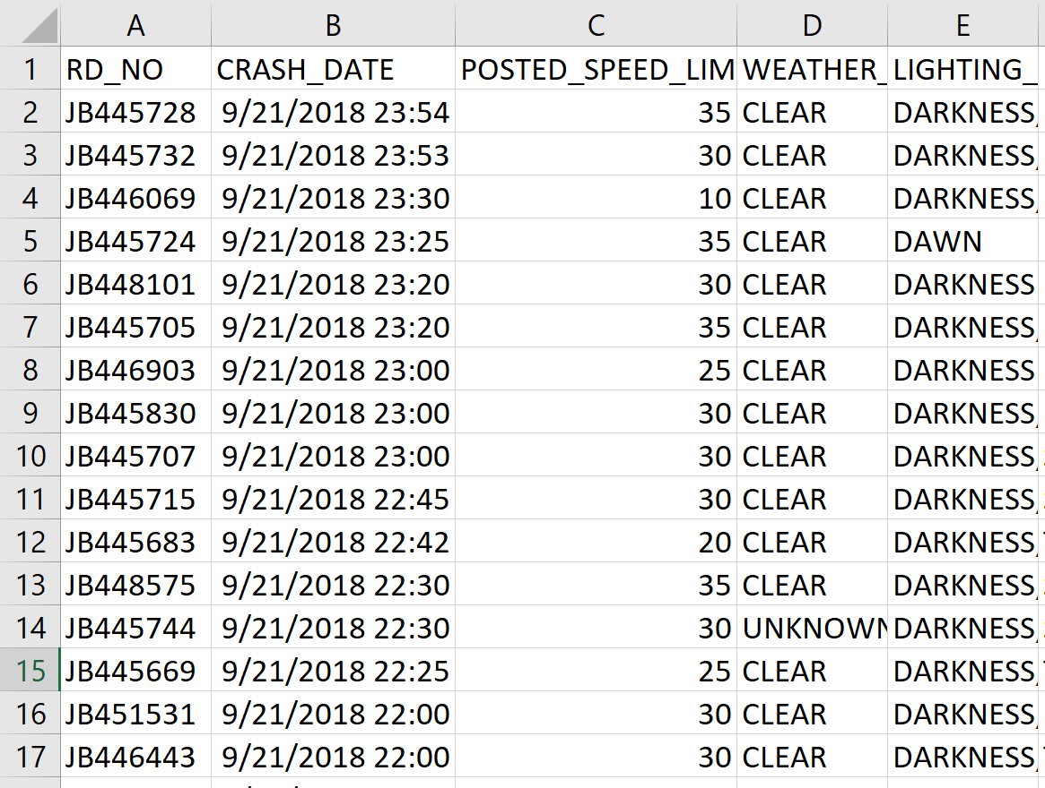
Traffic Crashes
200k+ records
Consistent
Uniform
Standardized

Slide 8
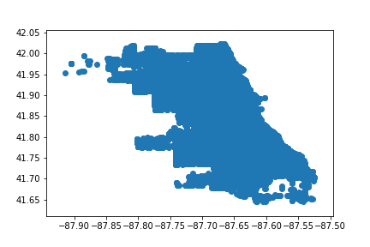
Traffic Crashes - Visualization
Plot crash geolocations on graph

Slide 9
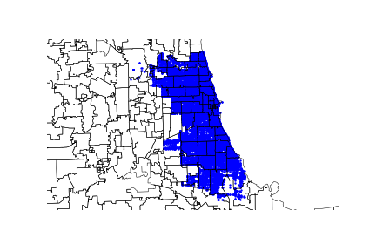
Traffic Crashes - Visualization
Plot crash geolocations on graph
Not very meaningful, plot against a map…
More details! Southeast Chicago seemed to be free from crashes, why?

Slide 10
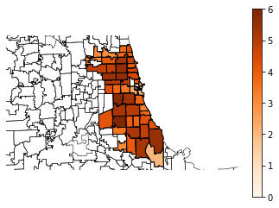
Traffic Crashes - Visualization
Plot crash geolocations on graph
Not very meaningful, plot against a map
More details, Southeast Chicago seemed to be free from crashes
Plot Chicago population density data

Slide 11
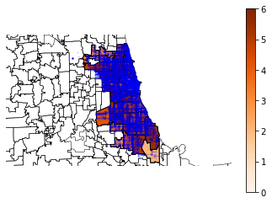
Traffic Crashes - Visualization
Plot crash geolocations on graph
Not very meaningful, plot against a map
More details, Southeast Chicago seemed to be free from crashes
Plot Chicago population density data
Plot crashes with population densities

Slide 12
Traffic Crashes - Preprocessing
Start was 200k+ crash entries, 48 features
From 2014 to today
Also had two more datasets
Vehicles involved (450k+ entries, 71 features)
People involved (500k+ entries, 29 features)
Challenges:
Scaling down the data for a feasible project
Combining Crash/People/Vehicle datasets
Making the data interpretable by an algorithm
Handling empty entries
Reducing the number of features

Slide 13
Traffic Crashes - Preprocessing
Challenges
Scaling down the data for a feasible project
Combining Crash/People/Vehicle datasets
Making the data interpretable by an algorithm
Handling empty entries
Reducing the number of features

Slide 14
Traffic Crashes – Preprocessing Scaling down the data
Vehicle data very sparse and hard to standardize w/o vehicle database
Different years meant
Different road systems, road condition
Different safety standards
Different seasons meant
Different weather conditions
Different common reasons for crashes
Different severity levels for crashes
Solution: High level decision of only using crash & people data from summer 2018 made (30k crash entries, 67k people entries)

Slide 15
Traffic Crashes - Preprocessing
Challenges
Scaling down the data for a feasible project
Combining Crash/People datasets
Making the data interpretable by an algorithm
Handling empty entries
Reducing the number of features

Slide 16
Traffic Crashes – Preprocessing Combining crashes/people
Both crashes and people included the report number (RD_NO) column
Can be used as unifier
Multiple people can be involved in a single crash
Therefore the RD_NO column will be repeated in the people dataset
Solution: Join people on crashes
Use Excel formula to append crash information to every person that has the same RD_NO
This is similar to a left outer join from people on crashes, with the condition being RD_NO
Now every entry was a person that was involved in the crash, and the circumstances of the crash they were involved in

Slide 17
Traffic Crashes - Preprocessing
Challenges
Scaling down the data for a feasible project
Combining Crash/People datasets
Making the data interpretable by an algorithm
Handling empty entries
Reducing the number of features

Slide 18
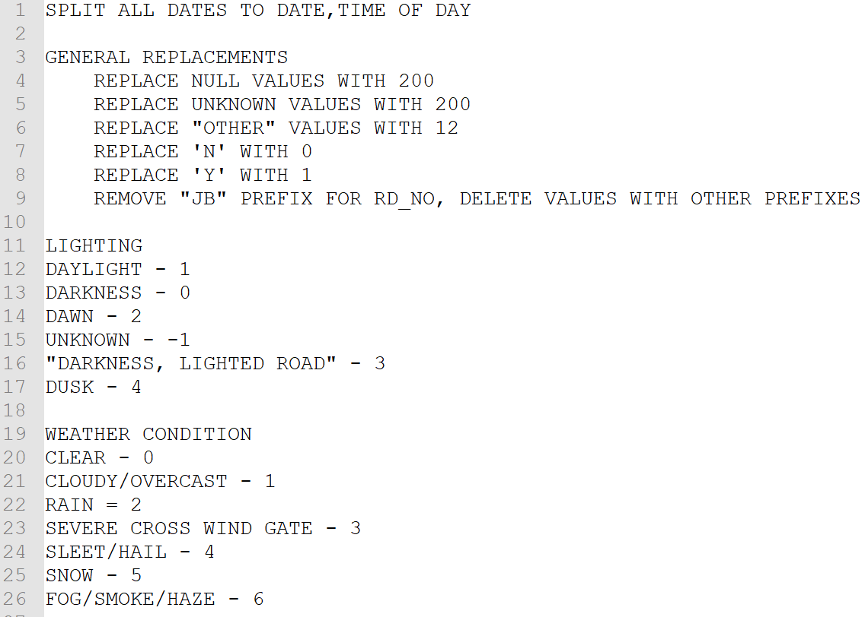
Traffic Crashes – Preprocessing Making the data interpretable
Crashes included many string descriptions
E.g: light, darkness, dusk, dawn
Computers can’t understand English
Many empty values existed
Solution: Manually enumerate all values
Record a mapping of what each number means
Assign number 200 to empty values
Reuse that number for the value “UNKNOWN”

Slide 19
Traffic Crashes - Preprocessing
Challenges
Scaling down the data for a feasible project
Combining Crash/People datasets
Making the data interpretable by an algorithm
Handling empty entries
Reducing the number of features

Slide 20
Traffic Crashes – Preprocessing Feature Reduction
A vast number of features were redundant/irrelevant/consequents
CRASH_DATE was repeated twice
Pedestrians/Bicyclists don’t have a VEHICLE_NO
Whether or not they were transported to an ER is a consequent
Solution: Delete those columns, let the data mining algorithm take care of finding actually relevant features
Project goal set: Determine the INJURY_CLASSIFICATION for any person involved in a car crash

Slide 21
Traffic Crashes - Transformation
Data was very imbalanced, out of 67k crashes
61k had no indication of injuries
3.5k were injured (NONINCAPACITATING_INJURIES)
36 were fatal
Different algorithms required different data shapes

Slide 22
Traffic Crashes - Transformation

Slide 23
Traffic Crashes – Data Mining

Slide 24
Traffic Crashes – Data Mining

Slide 25
Traffic Crashes – Data Mining

Slide 26
Traffic Crashes – Data Mining

Slide 27
Traffic Crashes – Evaluation

Slide 28
Traffic Crashes – Evaluation

Slide 29
Traffic Crashes – Interpretation

Slide 30
Traffic Crashes – Interpretation

Slide 31
Next Steps
Apply a similar algorithm to Fall/Winter/Spring Crashes

